Slide 1
The Devil’s Financial Dictionary and The Intelligent Investor
Lessons from the History of Fashion and Folly
Jason Zweig
The Wall Street Journal
Talks at Google
March 22, 2016

Slide 2
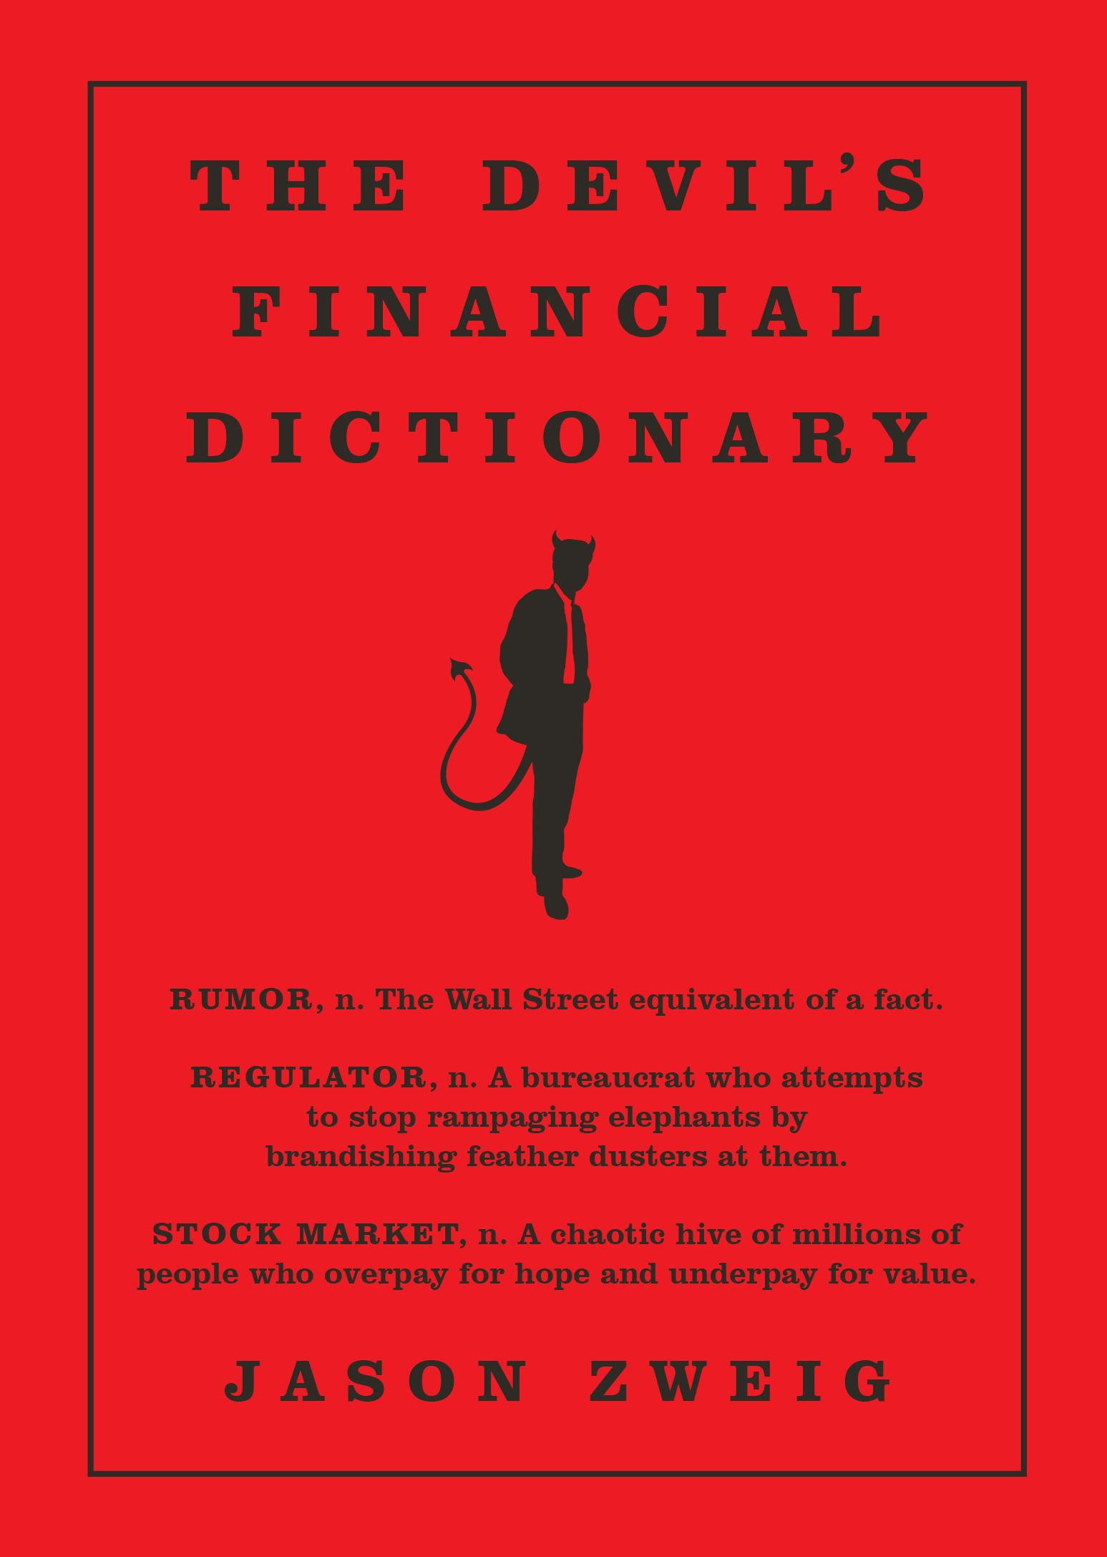

Slide 3
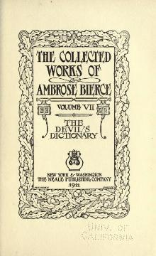

Slide 4
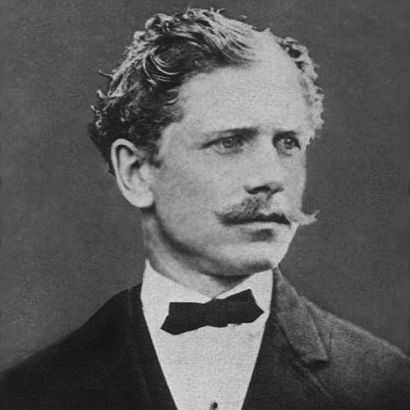

Slide 5
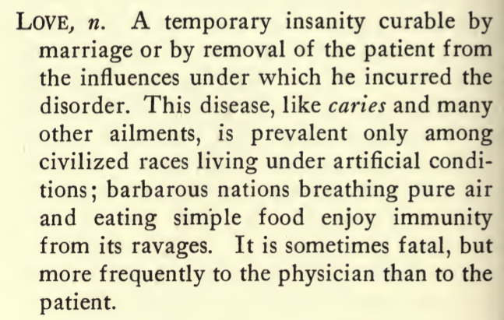

Slide 6
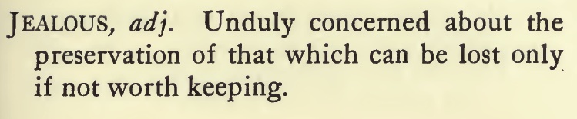

Slide 7
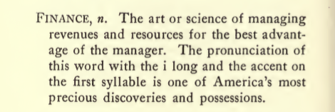

Slide 8
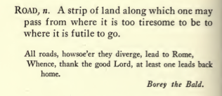

Slide 9
Why this book?
Carlyle: economics
What does that make investing?
Dry, dull, tedious, repetitive, gibberish, gobbledygook
But if you can…
Very long term: economics
ST, MT, even fairly LT: psychology
Etymology → hidden meanings
History as psychological record: chronicle of other people’s [mis]judgments
Disconfirmation!

Slide 10
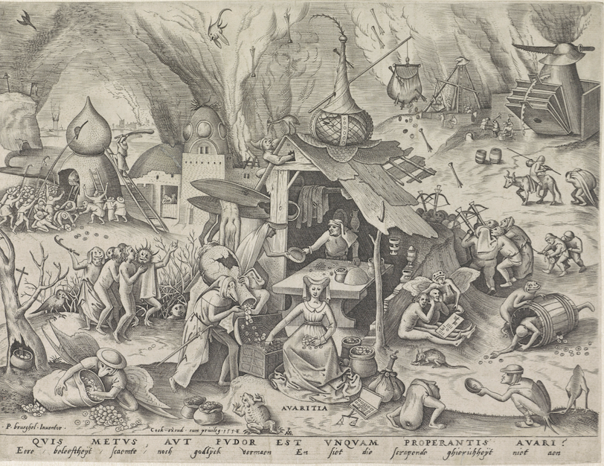

Slide 11


Slide 12


Slide 16


Slide 17
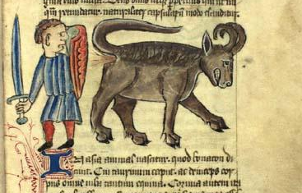

Slide 21
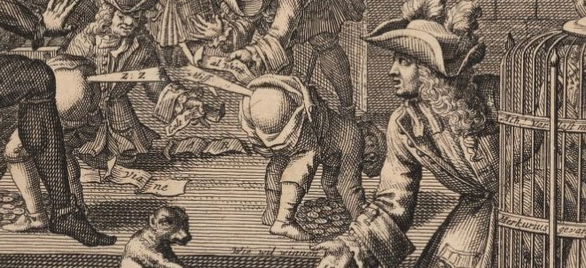

Slide 22
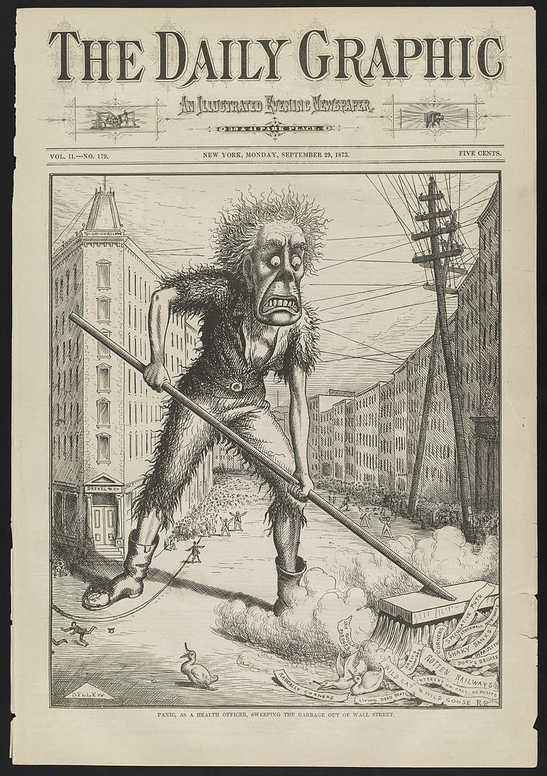

Slide 25
Charlie Munger on Darwin: “...he always gave priority attention to evidence tending to disconfirm whatever cherished and hard-won theory he already had.”
Warren Buffett on Darwin: “whenever he ran into something that contradicted a conclusion he cherished, he was obliged to write the new finding down within 30 minutes. Otherwise his mind would work to reject the discordant information, much as the body rejects transplants. Man’s natural inclination is to cling to his beliefs, particularly if they are reinforced by recent experience.”

Slide 26
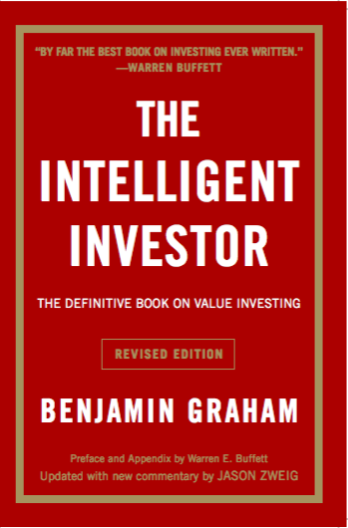

Slide 27
What Makes an “Intelligent” Investor?
Nothing to do with IQ or standardized test scores
MBA, PhD, CFA, CFP, CPA not required
“The word ‘intelligent’ in our title will be used throughout the book in its common and dictionary sense as meaning ‘endowed with the capacity for knowledge and understanding.’ It will not be taken to mean ‘smart’ or ‘shrewd,’ or gifted with unusual foresight or insight. Actually the intelligence here presupposed is a trait more of the character than the brain.”
Patience
Prudence
Independence & skepticism
Eagerness to learn
Discipline
Self-control (ability to harness your emotions)

Slide 28
Defensive vs. Enterprising
The conventional investor: spectrum based on [purported] appetite or capacity for taking risk
“conservative”
“moderate”
“aggressive”
risk tolerance almost impossible to measure ex ante
The intelligent investor: spectrum based on effort and commitment
“defensive”: priorities are “avoidance of serious mistakes or losses” and “freedom from effort, annoyance, and the need for making frequent decisions”
“enterprising”: defining trait is “willingness to devote time and care to the selection of securities that are both sound and more attractive than the average”
willingness to work at it: extremely easy to measure

Slide 29
Margin of Safety
The conventional investor:
How much money will I make when I’m right?
The intelligent investor:
How much money will I lose if I’m wrong?

Slide 30
Individual vs. Institutional Investors
Are individuals at a disadvantage to institutions?
“Individual investors can beat the pros at their own game”
But…!
Professional investors must measure success…
relative to a market index
short-term
Individual investors need only measure success relative to…
their personal goals!
“What do you care what other people think?”
You could, and probably should, have an investment time horizon of up to 100 years.

Slide 31
“But note this important fact: The true investor scarcely ever is forced to sell his shares, and at all other times he is free to disregard the current price quotation. He need pay attention to it and act upon it only to the extent that it suits his book, and no more. Thus the investor who permits himself to be stampeded or unduly worried by unjustified market declines in his holdings is perversely transforming his basic advantage into a basic disadvantage. That man would be better off if his stocks had no market quotation at all, for he would then be spared the mental anguish caused him by other persons’ mistakes of judgment.”
-- Benjamin Graham, The Intelligent Investor (Chapter 8)
“We have [heard] many complaints that institutional dominance of the stock market has put the small investor at a disadvantage because he can’t compete.... The facts are quite the opposite…. I am convinced that an individual investor with sound principles, and soundly advised, can do distinctly better over the long pull than a large institution. Where the trust company may have to confine its operations to 300 concerns or less, the individual has up to 3,000 issues for his investigations and choice. Most true bargains are not available in large blocks; by this very fact the institutions are well-nigh eliminated as competitors of the bargain hunter.”
-- Benjamin Graham, speaking at “The Renaissance of Value” seminar, 1974

Slide 32
Three Ways to Be Intelligent
Hunt for value where the professionals can’t go
smaller stocks
stinker stocks
stocks that are hard to understand
Be patient
years and decades
Be independent
“You are neither right nor wrong because the crowd disagrees with you. You are right because your data and reasoning are right.” -- The Intelligent Investor, Chapter 19
“It is easy in the world to live after the world’s opinion; it is easy in solitude to live after our own; but the great man is he who in the midst of the crowd keeps with perfect sweetness the independence of solitude.” -- Ralph Waldo Emerson

Slide 33
Thank you.
www.jasonzweig.com
Twitter: @jasonzweigwsj

